Slide 1

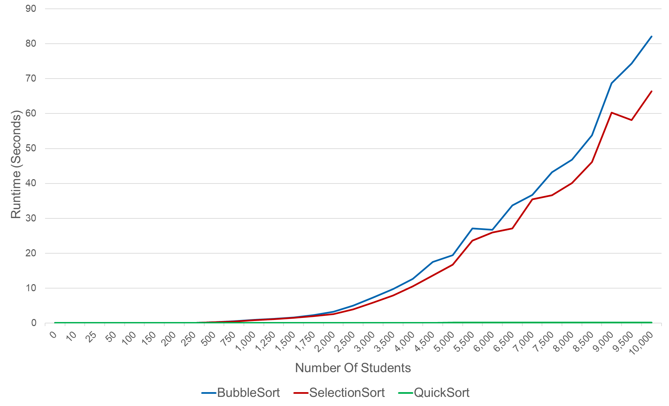
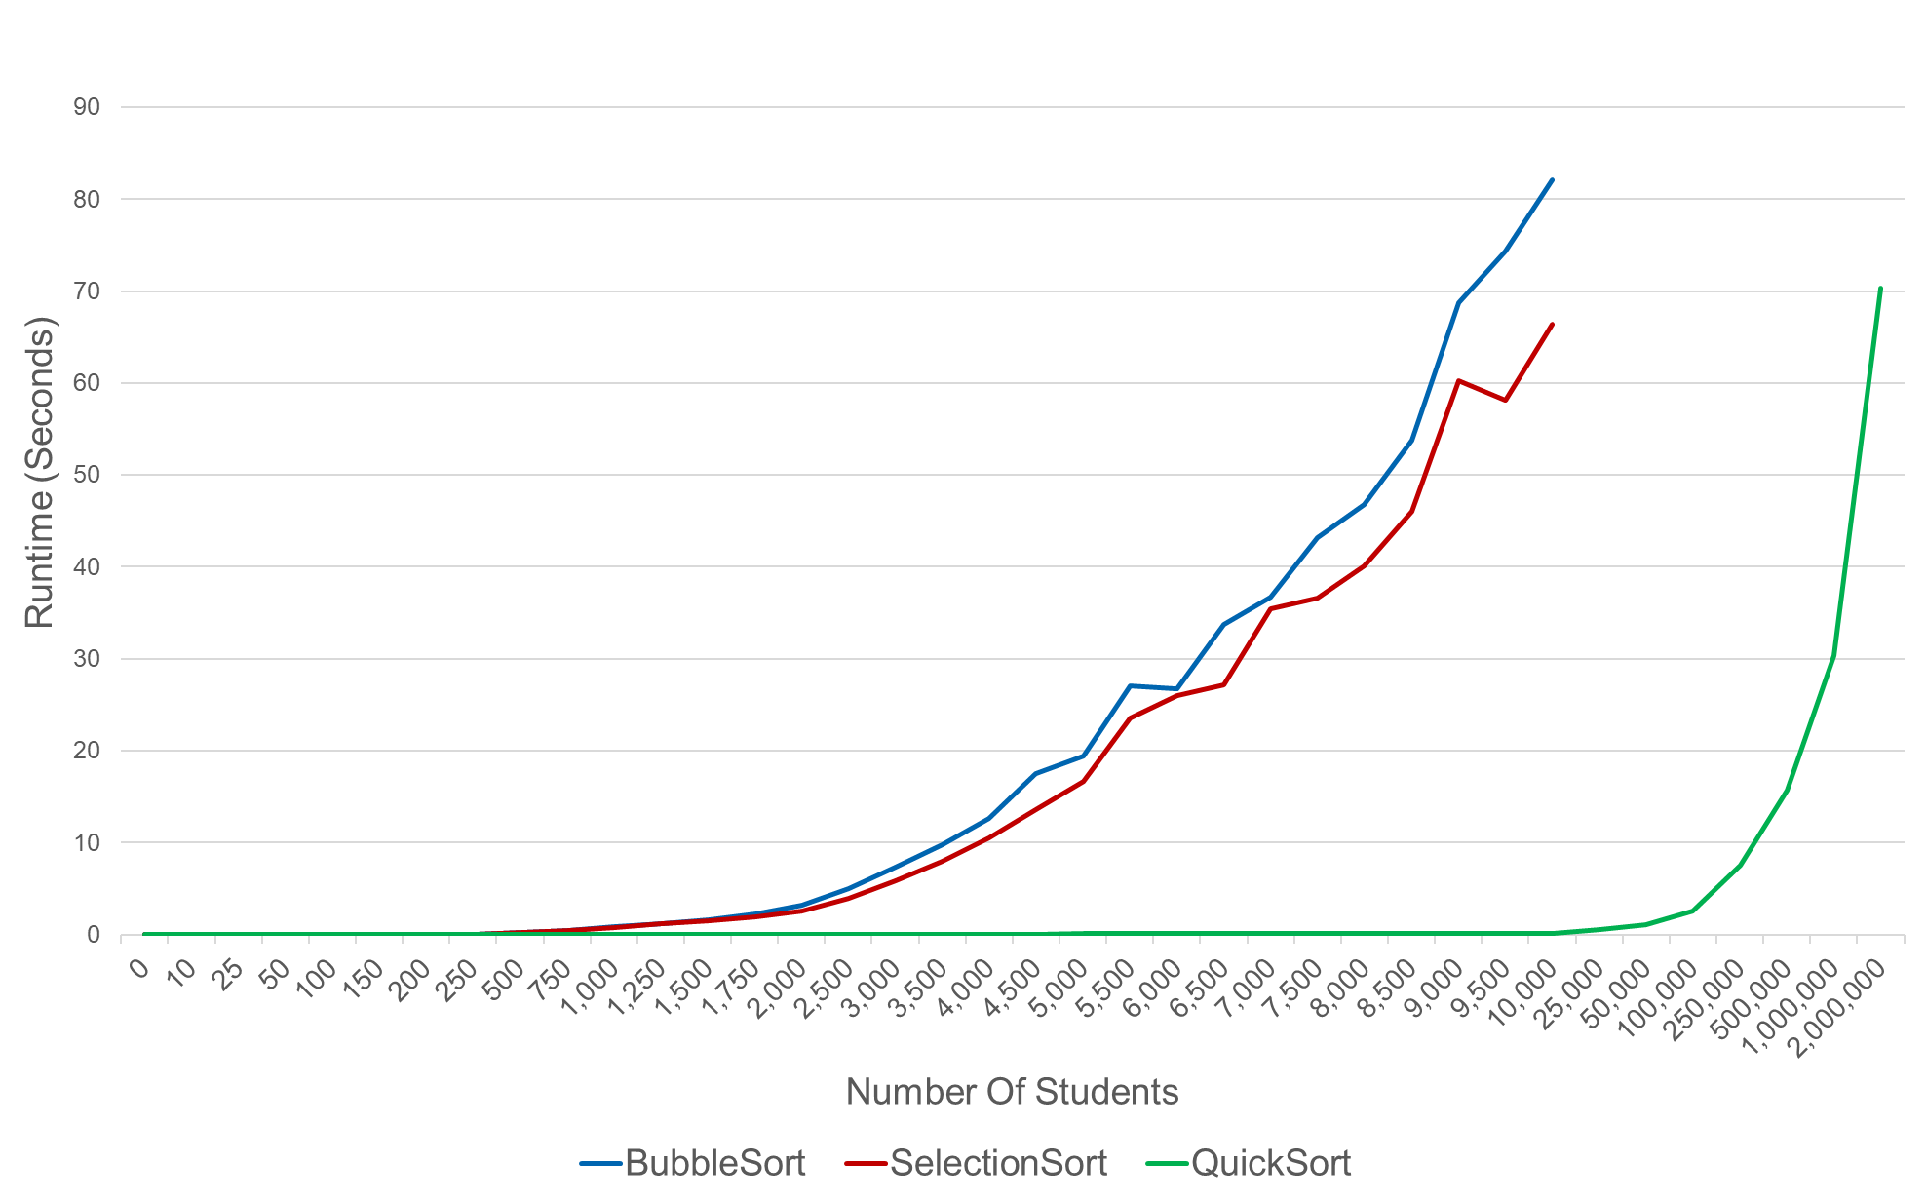
Time Analysis on Sorting Algorithms
Ronan Wallace
Macalester College – St. Paul, MN
Overview
Results
Summary
In this project, I aim to analyze three sorting algorithms when applied in a real world situation and demonstrate the effectiveness of Quick Sort. To do so, I collected average runtimes for each algorithm on a mock student sample of different sizes. After collecting averages from each algorithm, I compared them against each other to demonstrate their effectiveness, which I have measured by their quickness in seconds to successfully sort the generated student body.
Sorting Runtime Averages (0-10,000 Students)
Quick Sort is substantially better than Bubble and Selection Sort
At 10,000 students, Quick Sort is 450+ times quicker than Bubble Sort and 370+ times quicker than Selection Sort
If allotted a little over a minute of sorting time, Bubble Sort and Selection Sort can successfully sort around 10,000 students. Quick Sort, on the other hand, if given over a minute to sort, can successfully sort 2,000,000 students.
Quick Sort has a reputation of being one of the quickest sorting algorithms. These results demonstrate the power/quickness that Quick Sort has, especially compared to Bubble and Selection sorting algorithms.
Sorting Runtime Averages (0-2,000,000)
Challenges
Sorting Comparisons:
For each algorithm, you must figure out how string comparisons fit into each one
Figuring out how the students should be ordered if last/first/middle names are equivalent
Processing Time:
Patience required to wait for time results
Computer would sleep after long periods of inactivity
Future Improvements
Completing this project, I learned a lot about implementing sorting algorithms and how to they can be applied to real world applications. Looking ahead of this project, there are several things that I would do to improve the program/results:
Implement other sorting algorithms to compare with Quick Sort (i.e. Merge, Insertion)
Test the program on other computers to get a variety in processors and see how runtimes are
Add some more analyzing functions to further automate and display average runtimes nicely
Collected Runtime Data
Program
Number Of Students | Bubble Sort | Selection Sort | Quick Sort
0 | 0 | 0 | 0
10 | 0 | 0.000106256 | 1.99509E-05
25 | 0.00031924 | 0.000130966 | 0.00011641
50 | 0.002409113 | 0.001690326 | 0.000565391
100 | 0.007748618 | 0.006679323 | 0.000866473
150 | 0.02100086 | 0.01744391 | 0.001921098
200 | 0.037409713 | 0.030068643 | 0.002952735
250 | 0.062453599 | 0.047720959 | 0.003412092
500 | 0.223091047 | 0.197078767 | 0.008684163
750 | 0.497668762 | 0.453995063 | 0.012649984
1000 | 0.897131434 | 0.781885805 | 0.018387694
1250 | 1.210062389 | 1.147180109 | 0.01743844
1500 | 1.586077671 | 1.53902133 | 0.022523394
1750 | 2.227385063 | 1.971679964 | 0.026065769
2000 | 3.207566118 | 2.582212343 | 0.029879437
2500 | 4.970083628 | 3.906236658 | 0.040422354
3000 | 7.326003399 | 5.833930836 | 0.047046652
3500 | 9.726740866 | 7.926814871 | 0.05308486
4000 | 12.64284131 | 10.49322001 | 0.063460302
4500 | 17.47618754 | 13.58378408 | 0.075982313
5000 | 19.44717924 | 16.69822828 | 0.092132998
5500 | 27.07385817 | 23.59087663 | 0.096380162
6000 | 26.70070846 | 25.95218172 | 0.125172544
6500 | 33.74729593 | 27.15337875 | 0.110757661
7000 | 36.74432371 | 35.44636109 | 0.137232781
7500 | 43.23001728 | 36.59092236 | 0.128209686
8000 | 46.7554215 | 40.09363937 | 0.137434411
8500 | 53.80652945 | 46.07532125 | 0.147235346
9000 | 68.70116537 | 60.26264181 | 0.180229831
9500 | 74.37110059 | 58.11670346 | 0.174356461
10000 | 82.07591312 | 66.37137508 | 0.17914815
25000 | Takes too much time to process |  | 0.52499125
50000 |  |  | 1.136389089
100000 |  |  | 2.576892948
250000 |  |  | 7.539169502
500000 |  |  | 15.74522605
1000000 |  |  | 30.39096577
2000000 |  |  | 70.29541013
main.py
Main file where all functions are called; beginning of program.
student_data_generator.py
A mock student body as an array of arrays is generated here. Each student is uniquely and randomly generated. Each student is an array consisting of their first name, middle initial, last name, student ID, year, major, and GPA. The additional information is included to make the student body more realistic.
sorting_library.py
Library containing the three sorting algorithms, Bubble Sort, Selection Sort, and Quick Sort, along with automated runtime collection functions. The students are sorted by last name, then first name, then middle initial.
Number of times sorted was adjusted according to size of student body and time it would take to process to calculate averages
0 – 1,000 students: 100 sorts; 1,250-2,000 students: 50 sorts; 2,500-5,000 students: 25 sorts; 5,500-2,000,000 students: 10 sorts

